Slide 1
WHO Information Network for Epidemics
Coronavirus disease (COVID-19)
2019 - 2020
Update #13 03.03.20

Slide 2
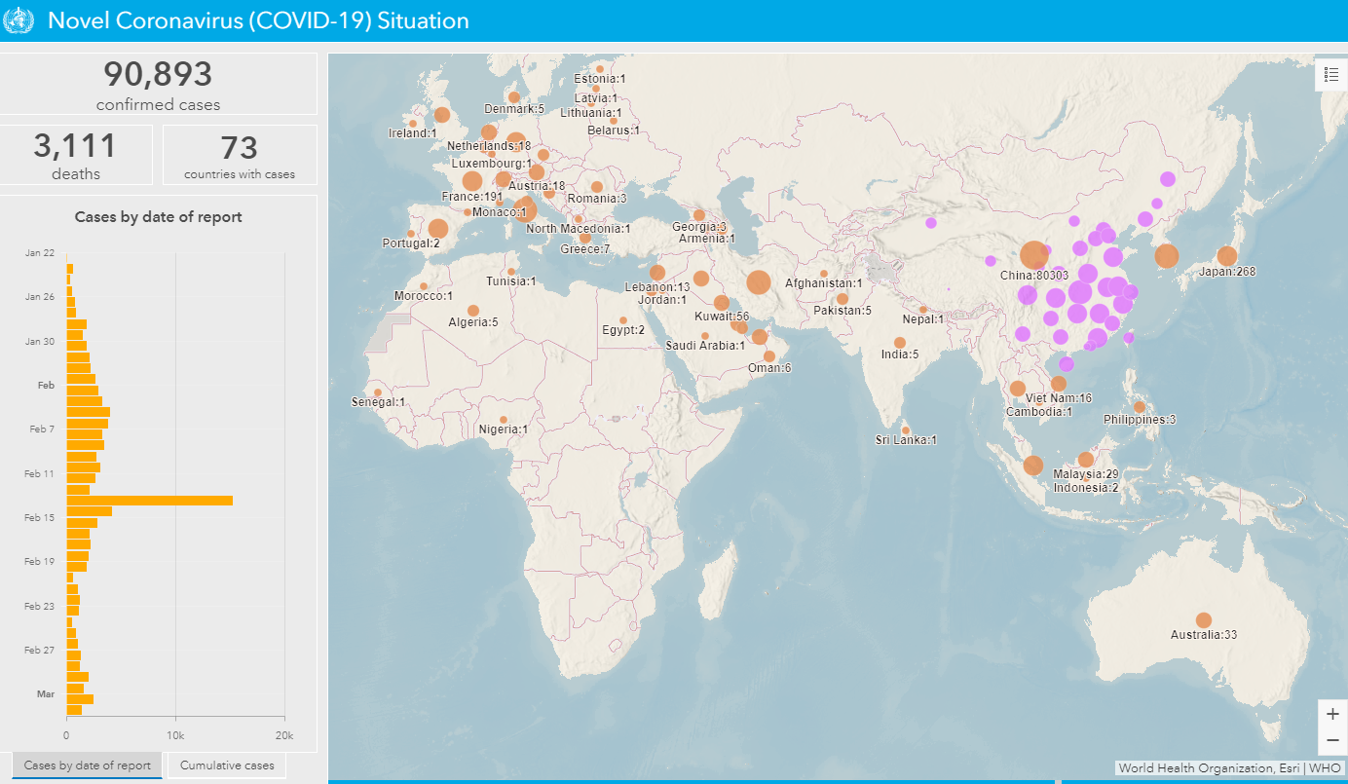
Current Situation Globally: 90,893 confirmed cases and 3,110 deaths
Cases by country/territory/area (as of 3 March 6am Gva)
Updates from last 24 hours
China:
129 new confirmed cases: 88% (114) cases from Hubei
31 new deaths: Hubei (100%)
129 new suspected cases
Outside China:
1,848 new confirmed cases: Republic of Korea(600), Iran (Islamic Republic of)(523), Italy(347), France(91), Spain(69), Japan(29), Germany(28), United States of America(26), Kuwait(10), Canada(8), Austria(8), San Marino(7), Iraq(7), Belgium(7), Switzerland(6), Norway(6), Iceland(7), Australia(6), Netherlands(5), Malaysia(5), Ecuador(5), Qatar(4), Algeria(4), The United Kingdom(3), Mexico(3), Lebanon(3), Israel(3), Singapore(2), Portugal(2), Morocco(2), Indonesia(2), India(2), Croatia(2), Bahrain(2), Tunisia(1), Thailand(1), Sweden(1), Senegal(1), Saudi Arabia(1), Russian Federation(1), Pakistan(1), Latvia(1), Jordan(1), Finland(1), Egypt(1), Dominican Republic(1), Denmark(1), Andorra(1)
36 new deaths: Italy (17), Iran (Islamic Republic of)(12), Republic of Korea(6), France(1)
Source: WHO Situation dashboard https://experience.arcgis.com/experience/685d0ace521648f8a5beeeee1b9125cd

Slide 3
New Cases of COVID-19 since 1 February 2020

Slide 4
Key epidemiological insights from China
At diagnosis approx. 80% of cases are mild/moderate; 15% severe; 5% critical
Disease progression: approx. 10-15% of mild/moderate cases become severe, and approximately 15-20% of severe become critical
Average times:
from exposure to symptom onset is 5-6 days after infection;
from symptoms to recovery for mild cases is 2 weeks;
from symptoms to recovery for severe cases is 3-6 weeks;
from symptoms onset to death is from 1 week (critical) to 2-8 weeks.
COVID-19 much less frequent in children than adults, children tend to have milder disease

Slide 5
Current COVID-19 Transmission “Hotspots”

Slide 6
Hotspot: Italy
Hotspot: Italy
Main features of the outbreak:
2036 confirmed cases
52 deaths
An initial investigation by Italian authorities has found several clusters of cases in different regions of northern Italy, with evidence of local transmission of COVID-19.
Press release: http://www.euro.who.int/en/health-topics/health-emergencies/coronavirus-covid-19/news/news/2020/2/joint-who-and-ecdc-mission-in-italy-to-support-covid-19-control-and-prevention-efforts

Slide 7
Hotspot: Republic of Korea
Main features of the outbreak:
4812 confirmed cases
28 deaths
Approximately 77% have been reported from Daegu and Gyeongbuk area.
The recent deaths are all from hospitalized patients
The majority of the transmission to date is confined to people who were in a specific place at a specific time

Slide 8
Hotspot: Islamic Republic of Iran
Hotspot: Islamic Republic of Iran
Main features of the outbreak:
1501 confirmed cases
66 deaths
A WHO team is on the ground in Iran to provide support

Slide 9
The 3 “Cs” Scenarios
Key message: WHO believes that containment is possible in all settings. However, the measures taken by countries NOW to prepare for possible scenarios will determine the course of the outbreak.

Slide 10
Objectives: DELAY, PREVENT, CARE FOR COVID-19 CASES
Cases
Clusters
Community transmission
Scenario | No cases or first cases
Context | Importation from affected areas or initial case(s), with known link to other cases.
Aim | Stop transmission and prevent spread
Clusters
Increasing cases or clusters identified with or without an epidemiological link through diagnosis or surveillance.
Slow transmission and prevent spread
Community spread
Community transmission; cases without an epidemiologic link are common.
Slow transmission and reduce impact

Slide 11
COVID-19: Operational Planning Guidelines and COVID-19 Partners Platform to support country preparedness and response
In order to assist UN country teams in scaling up country preparedness and response to COVID-19, WHO has developed these learning modules as a companion to the Operational Planning Guidelines to Support Country Preparedness and Response.
This 3-module learning package introduces the context for the need for a coordinated global response plan to the COVID-19 outbreak. It provides the required guidance to implement the Operational Planning Guidelines to Support Country Preparedness and Response.
https://openwho.org/courses/UNCT-COVID19-preparedness-and-response-EN

Slide 12
Protecting your community and family members

Slide 13
What can I do to prevent the spread of COVID-19?
If you feel unwell, stay home
Do not go to work, to school or to public spaces to avoid transmission of COVID-19 to others in the community.
If you are unwell, you should self-isolate and self-monitor to avoid possible transmission to people in your community and family.

Slide 14
Question: What is self-isolation?
Explanation
*
Self-isolation is an important measure in order to avoid transmission of infection to others in the community, including family members.
Answer: Self-isolation is when a person who is ill (i.e., fever or respiratory symptoms), voluntarily or based on his/her health care provider’s recommendation, stays at home and does not go to work, school, or public places.
What can I do? If you feel unwell, stay home, and do not go to work and to public spaces.
*
If a person is in self-isolation it is because he/she is ill but not severely ill (requiring medical attention).
*
The person in self-isolation should ideally have a room at home that is separated from other family members. If not possible, spatial distance of at least 1 meter (3 feet) from other family members and the use of a medical mask is recommended for the ill person with respiratory symptoms. The person in self-isolation should have dedicated utensils, plates, cups, towels and linens.
*
The duration of self-isolation for a person with confirmed diagnosis of COVID-19 should be discussed with the healthcare provider and may require additional laboratory testing.

Slide 15
Question: What is self-monitoring?
Explanation
*
Self-monitoring is recommended for those who have been exposed to an individual known to have COVID-19 or who have been in a COVID-19 affected country.
Answer: Self-monitoring is done when a person is asymptomatic, and it includes daily measurement of temperature and monitoring for development of clinical symptoms such as cough or difficulty breathing.
What can I do? Self-monitor yourself if you think that you might have been exposed to COVID-19
*
Self-monitoring is recommended for 14 days after the date of last exposure.
*
If any symptoms appear, stay home and practice self-isolation. Call your health-care provider or hotline, explain your symptoms and possible exposure and follow the advice provided. Contact your medical provider urgently if you have difficulty breathing.

Slide 16
Science deep-dive

Slide 17
Update on clinical features in COVID-19: New study published
1,099 patients with laboratory-confirmed COVID-19 across 552 hospitals in 30 provinces of China.
Signs and symptoms when being admitted to hospital | % of patients
Cough | 67.8
Fever | 43.8
Fatigue | 38.1
Sputum production | 33.7
Shortness of breath | 18.7
Aches and pains (myalgia) | 14.9
Low white blood cell count | 83.2
Median age of patients: 47 years (IQR 35 – 58)
Median incubation period: 4 days (IQR 2 – 7)
3.5% were healthcare workers
40.9% had no abnormalities on chest X-ray at time of hospital admission
Median duration of hospitalization: 12 days (Mean 12.8 days
88.7% of patients developed fever during their hospital stay.
Clinical Characteristics of Coronavirus Disease 2019 in China. Wei-Jie Guan et al. New England Journal of Medicine, February 28, 2020 DOI: 10.1056/NEJMoa2002032

Slide 18
More information
WHO sources:
COVID-19 website: https://www.who.int/health-topics/coronavirus
WHO Travel Advice: https://www.who.int/ith/en/
Email: EPI-WIN@who.int
Website: www.EPI-WIN.com

